Slide 1

Module – IV : Staffing Level Estimation and Scheduling
Software Engineering (SE) → CSEN 3202 – CSE/BTech/6th Semester → Module-IV → Prepared by : Nilina Bera, CSE, HITK

Slide 2
Staffing level estimation
Once the effort required to develop a software has been determined, it is necessary to determine the staffing requirement for the project.
Putnam first studied the problem of what should be a proper staffing pattern for software projects.
He extended the work of Norden who had earlier investigated the staffing pattern of research and development (R&D) type of projects.
In order to appreciate the staffing pattern of software projects, Norden’s and Putnam’s results must be understood.
Nilina Bera

Slide 3
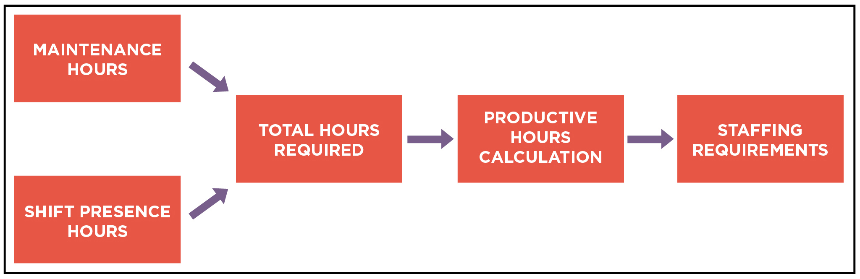
Nilina Bera

Slide 4
Norden’s Work
Norden studied the staffing patterns of several R & D projects. He found that the staffing pattern can be approximated by the Rayleigh distribution curve (as shown in fig.1). Norden represented the Rayleigh curve by the following equation:
E = K/t²^{d} * t * e^{-t² / 2 t²d}
Where E is the effort required at time t. E is an indication of the number of engineers (or the staffing level) at any particular time during the duration of the project, K is the area under the curve, and t^{d} is the time at which the curve attains its maximum value. It must be remembered that the results of Norden are applicable to general R & D projects and were not meant to model the staffing pattern of software development projects.
Nilina Bera

Slide 5
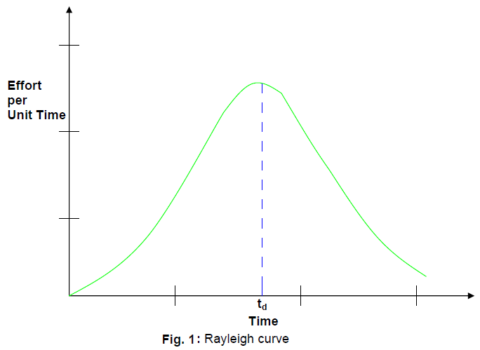
Nilina Bera

Slide 6
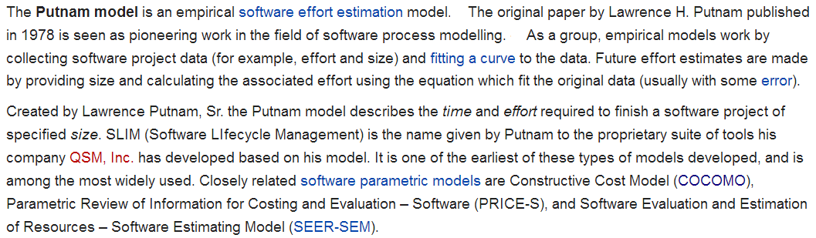
Putnam’s Work
Nilina Bera

Slide 7
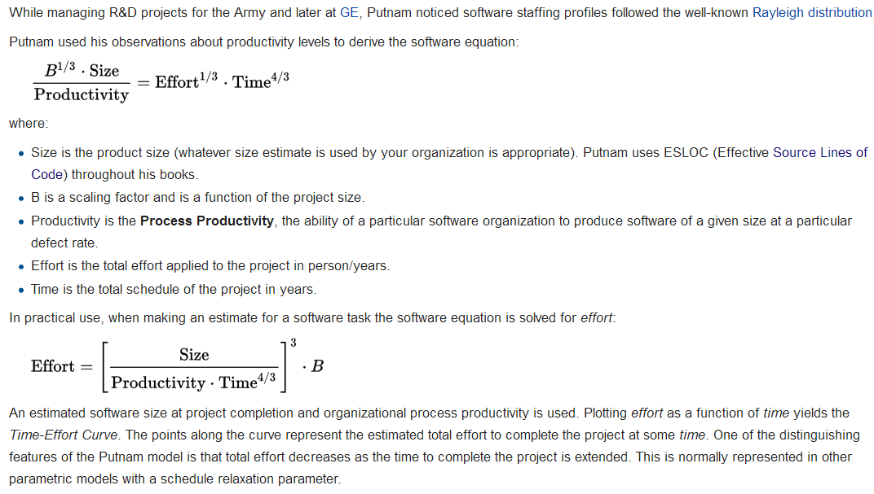
The Software Equation
Nilina Bera

Slide 8
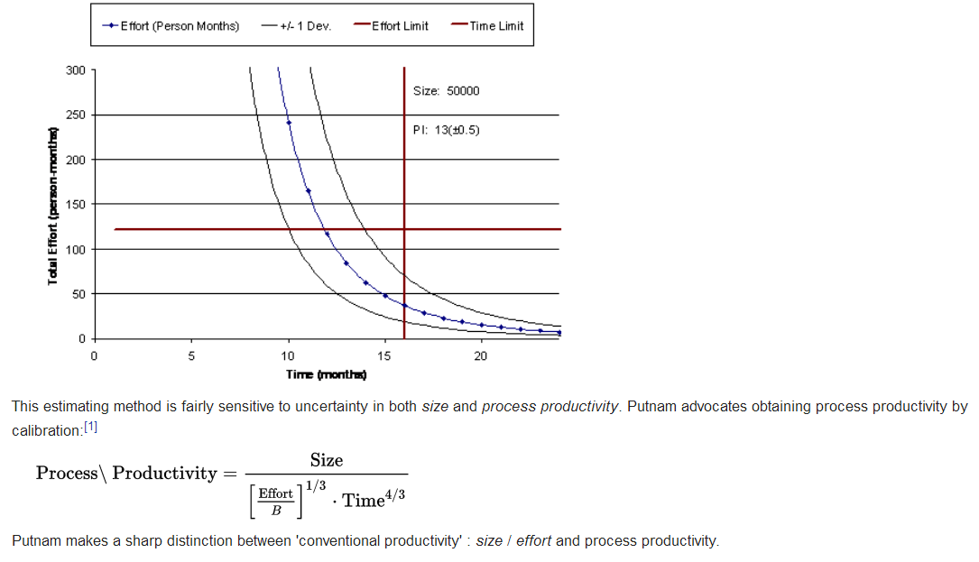
The Software Equation
Nilina Bera

Slide 9

Nilina Bera

Slide 10

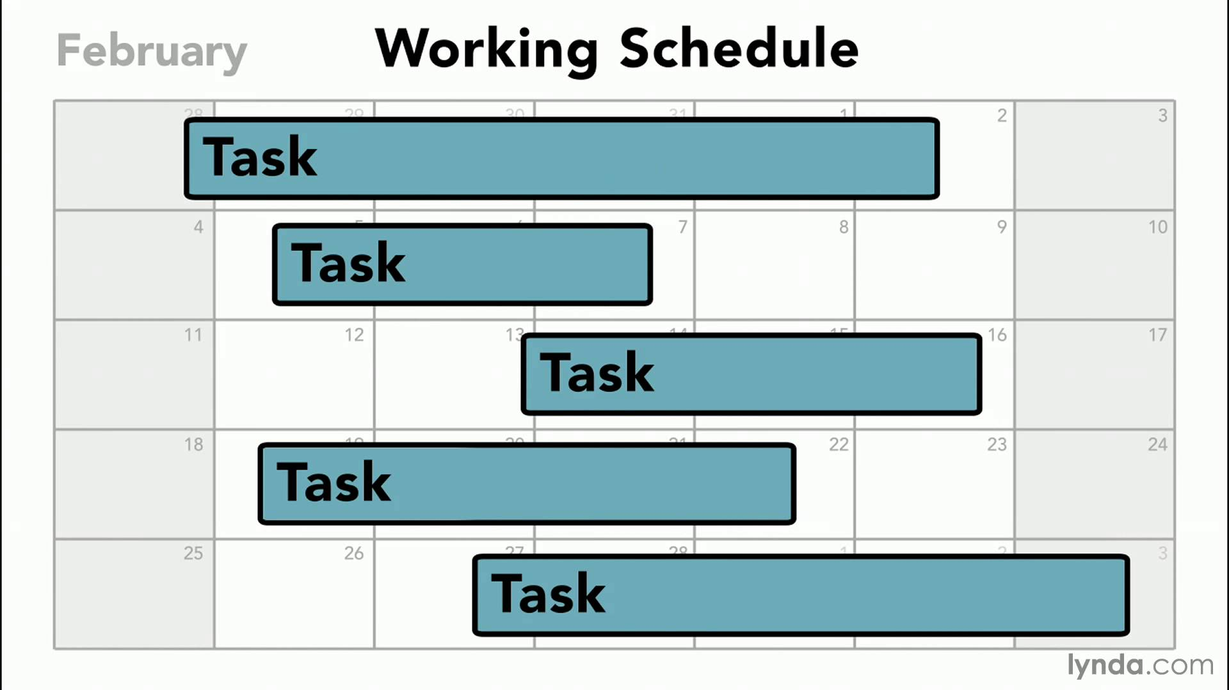
This working schedule is incomplete, because, five tasks are displayed without proper category. Question can be asked “What are these tasks in a software development project?”…. How they are performed? In which order?
Project scheduling is a mechanism to communicate what tasks need to get done and which organizational resources will be allocated to complete those tasks in what timeframe. A project schedule is a document collecting all the work needed to deliver the project on time.
Nilina Bera

Slide 11
What is Project scheduling ?
A project is a collection of tasks that must be
completed in minimum time or at minimal cost.
Objectives of Project Scheduling
  Completing the project as early as possible by determining the earliest start and finish of each activity.
  Calculating the likelihood a project will be completed within a certain time period.
  Finding the minimum cost schedule needed to complete the project by a certain date.
Nilina Bera

Slide 12
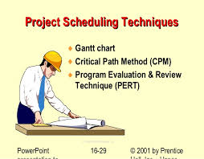
Nilina Bera

Slide 13
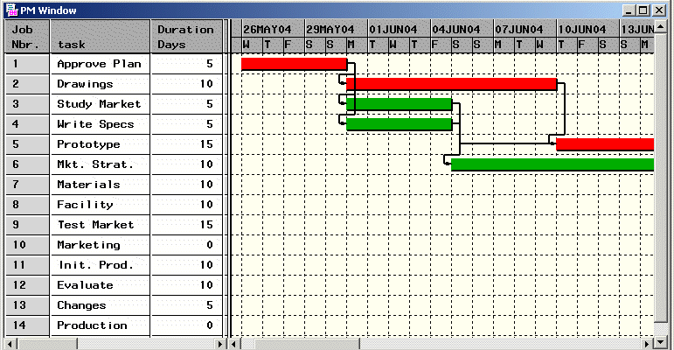
Nilina Bera

Slide 14
Project scheduling : Let’s dig into seriously…..
Project-task scheduling is an important project planning activity.
It involves deciding which tasks would be taken up when.
In order to schedule the project activities, a software project manager needs to do the following:
1. Identify all the tasks needed to complete the project.
2. Break down large tasks into small activities.
3. Determine the dependency among different activities.
4. Establish the most likely estimates for the time durations necessary to complete the activities.
5. Allocate resources to activities.
6. Plan the starting and ending dates for various activities.
7. Determine the critical path. A critical path is the chain of activities that determines the duration of the project.
Nilina Bera

Slide 15
Project scheduling
After the project manager has broken down the tasks and created the work breakdown structure, he has to find the dependency among the activities.
Dependency among the different activities determines the order in which the different activities would be carried out.
If an activity A requires the results of another activity B, then activity A must be scheduled after activity B (B < A).
In general, the task dependencies define a partial ordering among tasks, i.e. each tasks may precede a subset of other tasks, but some tasks might not have any precedence ordering defined between them (called concurrent task).
The dependency among the activities are represented in the form of an activity network.
Nilina Bera

Slide 16
Project scheduling
Once the activity network representation has been worked out, resources are allocated to each activity.
Resource allocation is typically done using a Gantt chart. After resource allocation is done, a PERT (Project Evaluation and Review Technique) chart representation is developed.
The PERT chart representation is suitable for program monitoring and control.
For task scheduling, the project manager needs to decompose the project tasks into a set of activities.
The time frame when each activity is to be performed is to be determined.
The end of each activity is called milestone.
The project manager tracks the progress of a project by monitoring the timely completion of the milestones.
If he observes that the milestones start getting delayed, then he has to carefully control the activities, so that the overall deadline can still be met.
Nilina Bera

Slide 17
Work breakdown structure
Work Breakdown Structure (WBS) is used to decompose a given task set recursively into small activities.
WBS provides a notation for representing the major tasks need to be carried out in order to solve a problem.
The root of the tree is labeled by the problem name.
Each node of the tree is broken down into smaller activities that are made the children of the node.
Each activity is recursively decomposed into smaller sub-activities until at the leaf level, the activities requires approximately two weeks to develop.
Fig. 2 represents the WBS of an MIS (Management Information System) software.
Nilina Bera

Slide 18
Work breakdown structure
While breaking down a task into smaller tasks, the manager has to make some hard decisions.
If a task is broken down into large number of very small activities, these can be carried out independently.
Thus, it becomes possible to develop the product faster (with the help of additional manpower).
Therefore, to be able to complete a project in the least amount of time, the manager needs to break large tasks into smaller ones, expecting to find more parallelism.
However, it is not useful to subdivide tasks into units which take less than a week or two to execute.
Very fine subdivision means that a disproportionate amount of time must be spent on preparing and revising various charts.
Nilina Bera

Slide 19
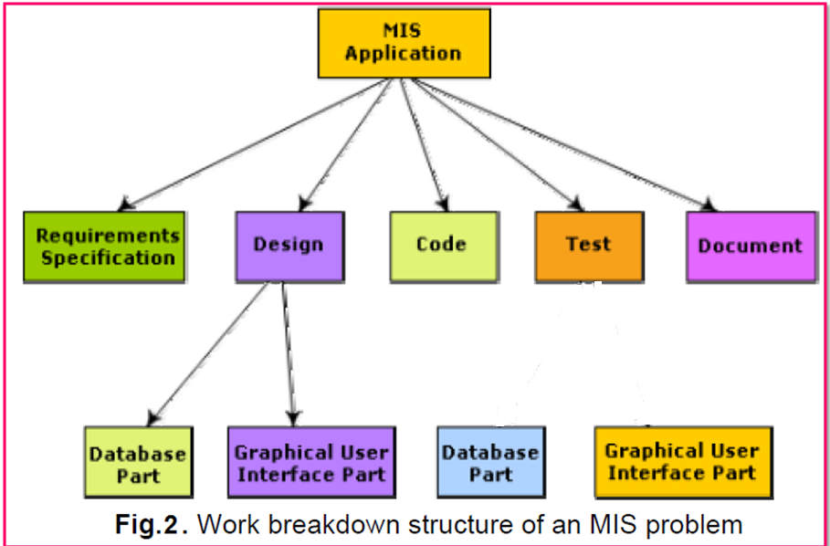
Work breakdown structure
Integrate and Test
Nilina Bera

Slide 20
Activity networks and critical path method
WBS representation of a project is transformed into an activity network by representing activities identified in WBS along with their interdependencies.
An activity network shows the different activities making up a project, their estimated durations, and interdependencies (as shown in fig.3).
Each activity is represented by a rectangular node and the duration of the activity is shown alongside each task.
Nilina Bera

Slide 21
Activity networks and critical path method
Managers can estimate the time durations for the different tasks in several ways.
One possibility is that they can empirically assign durations to different tasks. This however is not a good idea, because software engineers often resent such unilateral decisions.
A possible alternative is to let engineer himself estimate the time for an activity he can assigned to.
However, some managers prefer to estimate the time for various activities themselves.
Many managers believe that an aggressive schedule motivates the engineers to do a better and faster job.
However, careful experiments have shown that unrealistically aggressive schedules not only cause engineers to compromise on intangible quality aspects, but also are a cause for schedule delays.
A good way to achieve accuracy in estimation of the task durations without creating undue schedule pressures is to have people set their own schedules.
Nilina Bera

Slide 22
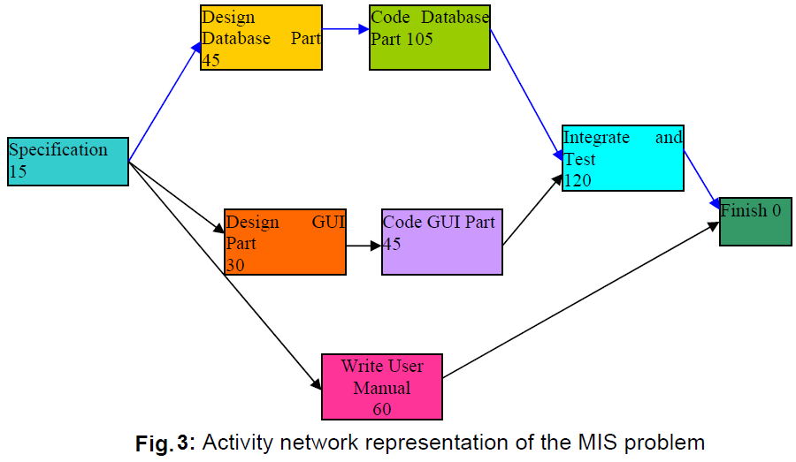
Activity networks and critical path method
This activity network represents duration of each activity (task)
Nilina Bera

Slide 23
Critical Path Method (CPM)
From the activity network representation following analysis can be made:
The minimum time (MT) to complete the project is the maximum of all paths from start to finish.
The earliest start (ES) time of a task is the maximum of all paths from the start to the task.
The latest start time is the difference between MT and the maximum of all paths from this task to the finish.
The earliest finish time (EF) of a task is the sum of the earliest start time of the task and the duration of the task.
The latest finish (LF) time of a task can be obtained by subtracting maximum of all paths from this task to finish from MT.
The slack time (ST) is LS – EF and equivalently can be written as LF – EF.
The slack time (or float time) is the total time that a task may be delayed before it will affect the end time of the project.
The slack time indicates the “flexibility” in starting and completion of tasks.
A critical task is one with a zero slack time.
A path from the start node to the finish node containing only critical tasks is called a critical path.
Critical Task ➔ The task with ZERO slack time. Any path whose duration equals MT is a critical path. There can be more than one critical path for a project.
MT = Minimum Time to complete the project
= Maximum of all paths from start to finish
= MAX(15+45+105+120, 15+30+45+120, 15+60)
= MAX(285, 210, 75)
= 285
Critical Path = Specification + Design DBMS + CODE DBMS + Integrate & Test = 15+45+105+120 = 285 days
Nilina Bera

Slide 24
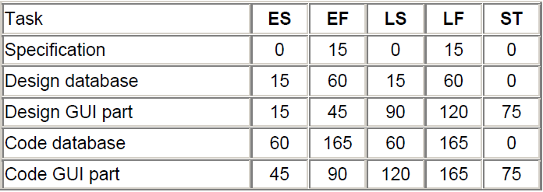
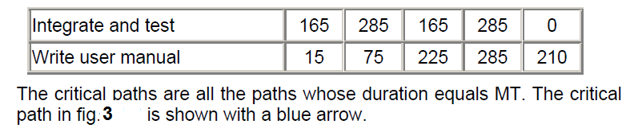
Critical Path Method (CPM)
These parameters for different tasks for the MIS problem are shown in the following table.
Nilina Bera

Slide 25
Gantt chart
Gantt charts are mainly used to allocate resources to activities.
The resources allocated to activities include staff, hardware, and software. Gantt charts (named after its developer Henry Gantt) are useful for resource planning.
A Gantt chart is a special type of bar chart where each bar represents an activity.
The bars are drawn along a time line.
The length of each bar is proportional to the duration of time planned for the corresponding activity.
Gantt charts are used in software project management are actually an enhanced version of the standard Gantt charts.
In the Gantt charts used for software project management, each bar consists of a white part and a shaded part.
The shaded part of the bar shows the length of time each task is estimated to take.
The white part shows the slack time, that is, the latest time by which a task must be finished. A Gantt chart representation for the MIS problem of fig.3 is shown in the fig.4.
Nilina Bera

Slide 26
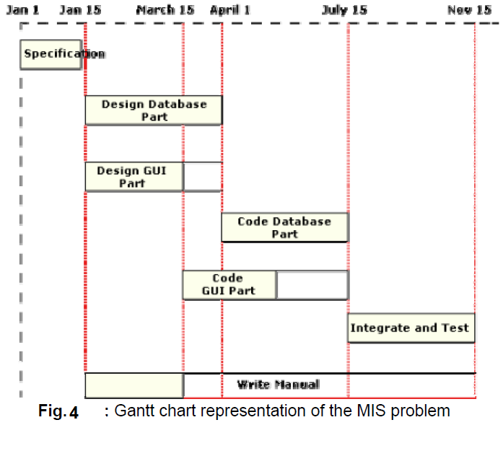
Gantt chart
Nilina Bera

Slide 27
PERT chart
PERT (Project Evaluation and Review Technique) charts consist of a network of boxes and arrows.
The boxes represent activities and the arrows represent task dependencies.
PERT chart represents the statistical variations in the project estimates assuming a normal distribution.
Thus, in a PERT chart instead of making a single estimate for each task, pessimistic, likely, and optimistic estimates are made.
The boxes of PERT charts are usually annotated with the pessimistic, likely, and optimistic estimates for every task.
Since all possible completion times between the minimum and maximum duration for every task has to be considered, there are not one but many critical paths, depending on the permutations of the estimates for each task.
This makes critical path analysis in PERT charts very complex.
A critical path in a PERT chart is shown by using thicker arrows.
The PERT chart representation of the MIS problem of fig. 4 is shown in fig. 5.
PERT charts are a more sophisticated form of activity chart.
In activity diagrams only the estimated task durations are represented.
Since, the actual durations might vary from the estimated durations, the utility of the activity diagrams are limited.
Nilina Bera

Slide 28
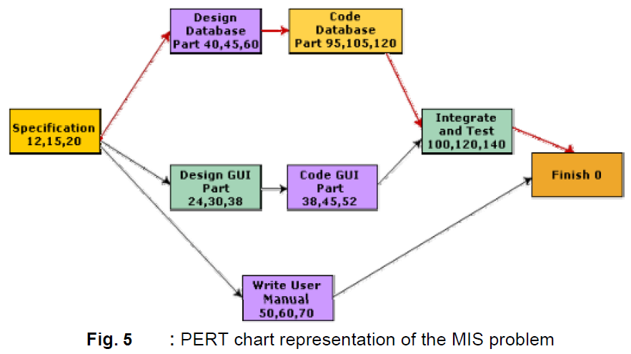
PERT chart
Gantt chart representation of a project schedule is helpful in planning the utilization of resources, while PERT chart is useful for monitoring the timely progress of activities. Also, it is easier to identify parallel activities in a project using a PERT chart. Project managers need to identify the parallel activities in a project for assignment to different engineers.
Pessimistic
Likely
Optimistic
Nilina Bera

Slide 29
PERT chart
Task | Pessimistic | Likely | Optimistic
Specification | 12 | 15 | 20
Design dbms part | 40 | 45 | 60
Code dbms part | 95 | 105 | 120
Design GUI part | 24 | 30 | 38
Code GUI part | 38 | 45 | 52
Integrate & Test | 100 | 120 | 140
Write User manual | 50 | 60 | 70
MT = Minimum time to complete the project = Maximum of all paths from start to finish = Calculation of MT with pessimistic completion time for each task in the activity network = {(12+40+95+100), (12+24+38+100), (12+50)} = {247, 174, 62} ➔ 247 days (tasks in critical path)
Nilina Bera

Slide 30
PERT chart
MT = Calculation of MT with Likely completion time for each task in the activity network = {(15+45+105+120), (15+30+45+120), (15+60)} = {285, 210, 75} ➔ 285 days (tasks in critical path)
MT = Calculation of MT with Optimistic completion time for each task in the activity network = {(20+60+120+140), (20+38+52+140), (20+70)} = {340, 250, 90} ➔ 340 days (tasks in critical path)
Nilina Bera

